Slide 1
Team 3: OP-project
By: Anna Lebedeff, Mohamed Mkhaibou, Khoa Nguyen and Sami Valkamaa

Slide 2
The project goal
Done so far
To predict future house prices until the end of 2021 given the area.
For as many different house types as possible.
Ability to follow the development of the prices quarterly.
The data from Tilastokeskus has been chosen and imputation of missing values has been made.
Some necessary data analysis has been made on the data.
Preliminary models, like have been applied on the data.

Slide 3
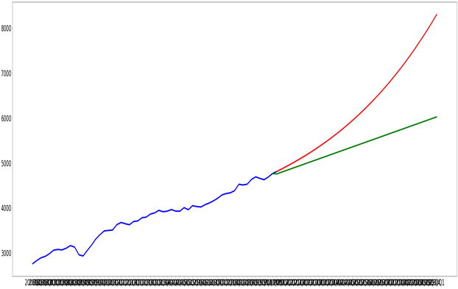
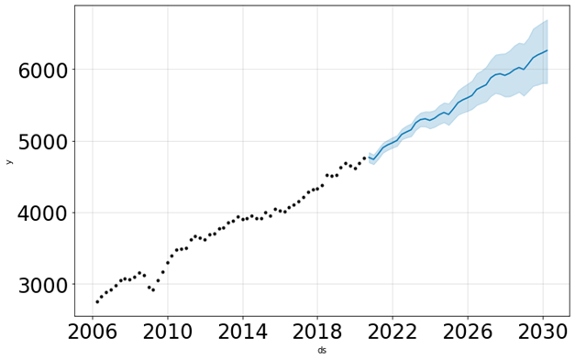
Models
Regression
Prophet
Red line = Polynomial Regression with degree = 58
Green line = Linear Regression
Solid prediction for the interval of 1 year. But not reliable for prediction in the long run
Blue line = prediction
Blue interval = error interval
Better forecasting with fluctuation of the time series taken into account.

Slide 4
Next steps
Still try other models that might capture e.g. the seasonality of the price changes.
Perform a grid search to find whether using the entire data from 2006 onwards is needed, or if another choice would prove more accurate.
Evaluate the performance of the models.
Starting to write documentation.

Slide 5
Thank you for your attention!

